Slide 1

A Visual
Rhetorical
Analysis
Kalie
CHarles

Slide 2

Use of Color and Visual Design

Slide 3
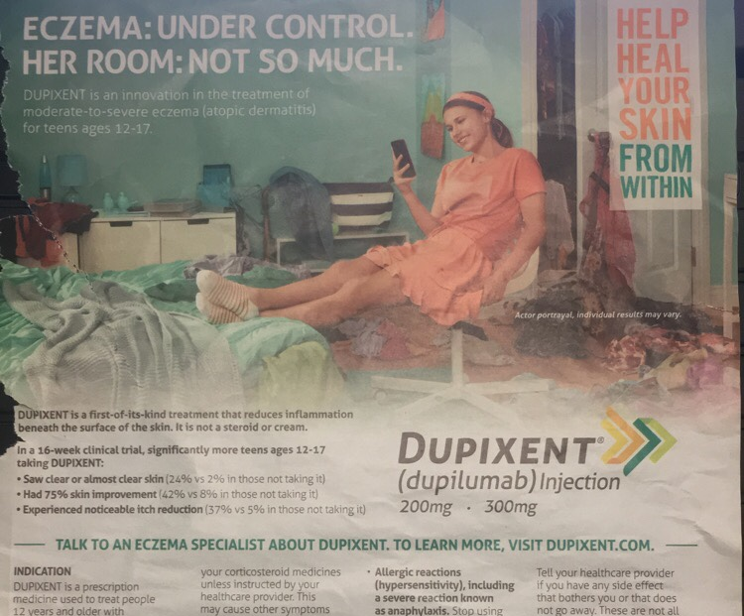
Visual Design

